Slide 1


Python Webapp Programming
Questionnaire app with Django:
Work with models

Slide 2
Questionnaire app: a rough design
Database
A list of question.
Each question has several answer options to choose
Each user come to participate all questions.
Restriction:
questions are single choice. User choose one from all the choices as answer.
One user should answer all questions then the questionnaire participate will be valid.
URL
Homepage showing the question list. (‘’)
Can participate the questionnaire and answer all questions.
Click on each question will open details of the question, with all answer options. (‘/question/<int:pk>/’)
Can check detail how many vote for each options of the question (‘/result/<int:pk>/’)
Each page has a “back to home” button at the bottom

Slide 3
Preparation
PS> mkdir QuestionPrj
PS> cd QuestionPrj
PS> pipenv --python 3
PS> pipenv install django
PS> %virtual_env dir%/Scripts/activate.ps1
(QuestionPrj) PS> $env.VIRTUAL_ENV
(QuestionPrj) PS> django-admin startproject QuestionPrj .
(QuestionPrj) PS> py manage.py startapp QuestionApp
This way of creating project will use current folder ‘.’
It will have one level of folder less compare with last time not using the current folder.

Slide 4
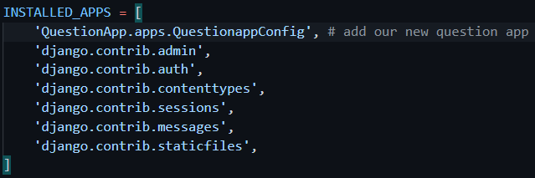

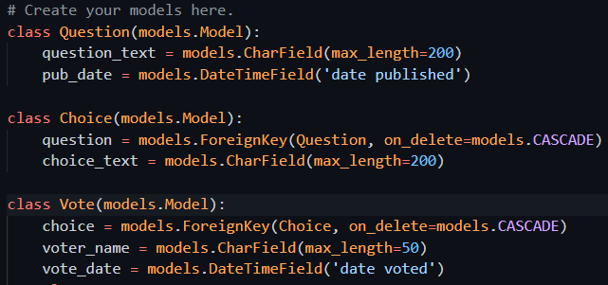
Define the database tables
At QuestionPrj/setting.py, add one line to include our app, also change TIME_ZONE:
Open QuestionApp/models.py, add code to define database tables:

Slide 5
Create tables in database
(QuestionPrj) PS> cd QuestionPrj
(QuestionPrj) PS> py manage.py makemigrations
(QuestionPrj) PS> py manage.py migrate
You will see that it not only create tables for our QuestionApp, but also a lot of other apps which are come from Django. (look back for those apps in the settings.py, INSTALLED_APPS)

Slide 6
Use python shell to manipulate the tables (directly using Django api)
(QuestionPrj) PS> cd QuestionPrj
(QuestionPrj) PS> py manage.py shell
You will be drop to a python interactive shell, and all our project settings already imported correctly.
Import our just defined models.
Can use Django API to add/remove/query tables.
>>> from QuestionApp.models import Question, Choice, Vote
>>> Question.objects.all()
<QuerySet []>
>>> from django.utils import timezone
# create one object (one record in table), and save it.
>>> q = Question(question_text="Your age?", pub_date=timezone.now())
>>> q.save()

Slide 7
>>> q.id
1
>>> q.question_text
'Your age?'
>>> q.pub_date
datetime.datetime(2021, 8, 30, 4, 48, 50, 770752, tzinfo=<UTC>)
# can change one record content and save it again.
>>> q.question_test = "Please choose your age range:"
>>> q.save()
>>> Question.objects.all()
<QuerySet [<Question: Question object (1)>]>
>>> q.choice_set.all()
<QuerySet []>
>>> c = Choice(question=q, choice_text="<=17",vote_quantity=0)
>>> q.choice_set.all()
<QuerySet []>
>>> c.save()
>>> q.choice_set.all()
<QuerySet [<Choice: Choice object (1)>]>
>>> Choice(question=q, choice_text=">=18, <=24").save()
>>> Choice(question=q, choice_text=">=25, <=35").save()
>>> Choice(question=q, choice_text=">=36, <=55").save()
>>> Choice(question=q, choice_text=">=56").save()
>>> q.choice_set.all()
<QuerySet [<Choice: Choice object (1)>, <Choice: Choice object (2)>, <Choice: Choice object (3)>, <Choice: Choice object (4)>, <Choice: Choice object (5)>]>

Slide 8
>>> Vote(choice=c,voter_name="Jack",vote_date=timezone.now()).save()
>>> c.vote_set.all()
<QuerySet [<Vote: Vote object (1)>]>
>>> q.choice_set.all()[0].vote_set.all()[0]
<Vote: Vote object (1)>
>>> q.choice_set.all()[1].choice_text
'>=18, <=24'
>>> q.choice_set.all()[1].vote_set.all()
<QuerySet []>
>>> q2 = Question.objects.get(pk=1)
>>> q2 == q
True
>>> c.vote_set.create(vote_date=timezone.now(),voter_name="Tom")
<Vote: Vote object (2)>
>>> c.vote_set.all()
<QuerySet [<Vote: Vote object (1)>, <Vote: Vote object (2)>]>
>>> Vote.objects.all()
<QuerySet [<Vote: Vote object (1)>, <Vote: Vote object (2)>]>

Slide 9
# record query / filtering from database. Using ‘__’ like when in python code using ‘.’ for attributes
>>> q_list = Question.objects.filter(pub_date__year=2021)
>>> q_list[0]
<Question: Question object (1)>
>>> q_list[0].question_text
'Please choose your age range:'
>>> c_list = Choice.objects.filter(question__pub_date__year=2020)
>>> c_list
<QuerySet []>
>>> v_list = Vote.objects.filter(voter_name__startswith='J')
>>> v_list
<QuerySet [<Vote: Vote object (1)>]>
>>> v_list[0].voter_name
'Jack’
>>> from datetime import timedelta
>>> c1 = Choice.objects.all()[1]
>>> c1.vote_set.create(voter_name=‘Lukas’,vote_date=timezone.now()-timedelta(days=1))
<Vote: Vote object (3)>
>>> Vote.objects.all()[2].voter_name
‘Lukas’
>>> Vote.objects.all()[1].delete()
>>> Vote.objects.all()
<QuerySet [<Vote: Vote object (1)>, <Vote: Vote object (3)>]>
Special syntax is used to avoid conflict with python interpreter.
Python will pass it as keyword parameter to filter() method, then inside filter() do special process, make SQL process.
More detail please check Django reference manual for “Making Queries”

Slide 10
Basic model operation methods
Create
Model class instantiation and save().
Manager create() method: Model.objects.create()
ForeignKey: use object instance to assign
ForeignKey relation: use …_set.create() (related_name)
ManyToMany field: .add(… , … , …) with object instance as parameters
Update
Get the object instance, then update related attributes will update the record
After update use save()
Retrieve
all()
filter(**kwargs)
exclude(**kwargs)
get(**kwargs): if the query only return back one object.
Chaining of those methods.
QuerySets[start:end], to use OFFSET and LIMIT clause to get a slice of the objects. (not allow negative indexes)

Slide 11
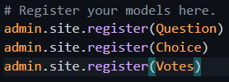
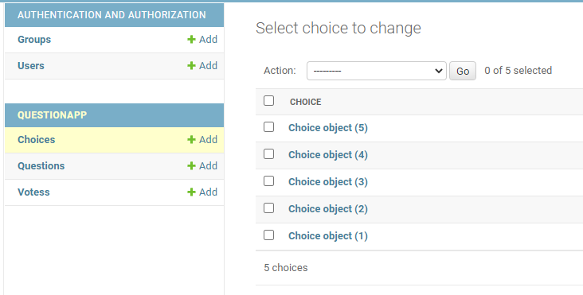
Use admin app of Django to manage database
Register the newly defined database table with admin in QuestionApp/admin.py:
Create superuser, and start server
User browser to open http://localhost:8000/admin/
Login with the superuser just created
Can see one user (tri), and many database records
But those record when shown not giving good information about themselves.
PS> py manage.py createsuperuser
PS> py manage.py runserver

Slide 12


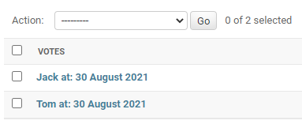
Add __str__ method to show database record info
For the class in models.py, add __str__() for each of them.

Slide 13
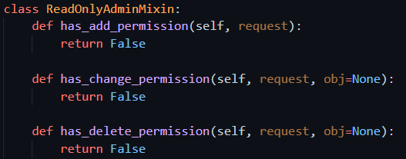

Customize admin
Vote is for user to sign in and update, so make admin readonly to this model
Now open the Vote in admin, cannot add/delete/edit

Slide 14
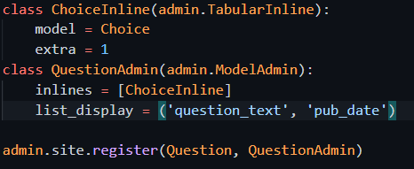
Customize admin
We can move the question and choice together so know the relation better
On the question list page, you still only see the information regarding the question
But on the question add/edit page, the choice will appear there

Slide 15
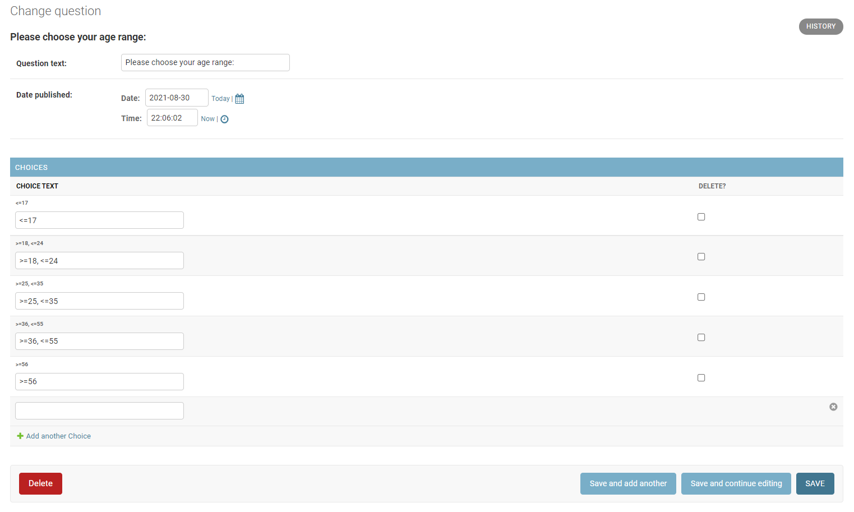

Slide 16
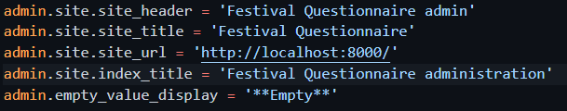
Customize admin
The title, header, are just “Django Administration”. We can change those information:
Add the following code to QuestionPrj/urls.py

